Slide 1
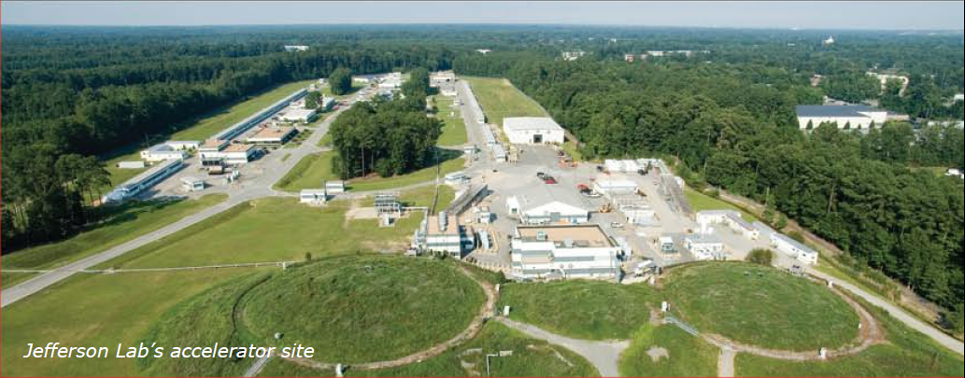
Some Logistics
Stephen Benson
March 5, 2012

Slide 2
Your Safety is Our Priority
If a fire alarm sounds:
Proceed down the stairs
Take the nearest exit
  If you exit to the right, please turn left into the lobby & exit the building through the double glass doors
  If you exit to the left, you will be outside
Muster in the parking lot
Stay clear of the building until instructed to return
Other Safety Issues
SRF Institute is being upgraded. Stay away from construction zones
No passing on site (and watch for deer)

Slide 3
Plenary Speakers
If your talk has not been uploaded to the FLS12 SPMS
please see Todd or Fay for assistance

Slide 4
Working Group Speakers
Please pre-load your talk
during break prior to your presentation at the latest
See your Working Group Convener
for assistance

Slide 5
Wireless network is available
throughout this building
Instructions in
your registration packet

Slide 6
Lunch is on your own
JLab Quark Café hours
11:30am to 1:30pm lunch
1:30 to 2pm snacks/beverages
Also open for breakfast

Slide 7
JLab FEL Tour
Wednesday March 7
15:15 to 17:30
If you have signed up,
please report to the atrium near the entrance at 3 p.m. Wednesday to fill out paperwork.

Slide 8
FLS Group Photo
Wednesday March 7
at 10:15
Immediately following first morning session and prior to coffee break

Slide 9
Conveners
WG1 Compact Light Sources
Bill Graves Andreas Maier
WG2 ERL Based Light Sources
Bettina Kuske Susan Smith
WG3 Electron Sources
Carlos Hernandez-Garcia Thorsten Kamps
WG4 FEL Based Light Sources
Kwang-Je Kim Tor Raubenheimer
WG5 Storage Ring Based Light Sources
Ricardo Bartolino Bob Hettel
WG6 Timing and Diagnostics
Steve Jamison Franz Kaertner
WG7 Undulators
Heinz-Dieter Nuhn Alexander Temnykh

Slide 10
Announcements/Reminders
THIS IS A WORKSHOP, NOT A CONFERENCE.
Working group leaders will provide a written summary of the group’s efforts for inclusion in the proceedings. They need your help doing this!
We will keep copies of the slide presentations and will request your permission to share these with the other attendees via our website. You may refuse permission though we would prefer that you just eliminate a few slides with any sensitive information and share the rest.
A campus map is provided in your folder. All meeting rooms are in this building. If you want to float between groups that is OK.
ICFA requires us to publish a conference proceedings. All oral presenters are expected to provide a paper in camera-ready JACOW format by 3/9/12. The link is on the conference website. Please contact the publication desk if you have difficulty meeting that requirement.
Most important: Have fun, learn a lot, and, when we are finished, go home excited about the opportunity to contribute to an important field
We gratefully acknowledge the financial support of SURA/JSA for this workshop

Slide 11
CEBAF Center
Auditorium
Fire Exits
L207(upstairs)
Cafeteria
L102/104
F-Wing
A110

